Slide 1
Asset management
Starting the conversation for sustainable service delivery
Notes:
Note to the Facilitator:
Welcome! This presentation template – Template 1 – is part of the “Starting the Conversation about Asset Management” toolkit.
Before starting to build your presentation, refer to the Facilitator’s Guide and Facilitator’s Worksheet that accompany this template.
How to use Template 1:
See Step 4 in the Guide and Worksheet for guidance and tips on choosing a template and selecting slides.
How to use these slides:
Select the slides that best suit your presentation goals and key messages.
Aside from the ‘title’ slide, the background colour of the slide indicates the level of detail that it communicates:
dark green background (overall/general topic, introductory, less time required)
white background (more in-depth information on a topic, opportunity for enhanced audience engagement, more time required)
Look for these icons that indicate the type of slide:
Key Message [icon of a key]
Inform [icon of a megaphone]
Engagement [icon of two people talking]
Example [icon of a piece of paper and a magnifying glass]
Customize your slides and notes by adding or removing content and including local context and visual aids.
A “case study” slide is located at the end of the template (slides 16)
How to use these notes:
Each slide contains the following information (where applicable):
Estimated time – indicates approximate time required to present slide content.
Facilitation Tip(s) – describes the slide and offers ideas on how to engage the audience.
Customization Opportunity – offers additional suggestions on content to add or other changes to make.
Speaking Notes – outline verbal points to be delivered to the audience. These notes can be added or adapted for customized slide content.
Engagement/Reflection Question(s): questions or prompts to engage your audience (either for individual reflection or large/small group discussion)
Illustrative examples: possible responses to help “unpack” the topics raised by the slide and answer audience questions.
Additional Notes – provide insights to consider, background information and/or resources where you can learn more to prepare for your presentation
-------------------------------------------------------------------------------------------------------------------------------------------------------------------
-------------------------------------------------------------------------------------------------------------------------------------------------------------------
Estimated Time: 30 seconds
Facilitation Tip: This title slide covers the overall goal and topics included in this presentation on asset management.
Customization Opportunity: Use or modify this title slide – or craft your own to capture your audience’s attention! It should convey your presentation goals and speak to your community’s asset management needs. (See Step 3 in the Guide and Worksheet for more on this.)
Speaking Notes:
Welcome, I am [your name & title]. Today I will be introducing you to asset management and how it makes our municipality more sustainable.
We will discuss strategies and tools that will ensure sustainable growth, inclusivity, and adaptability for our community's changing needs.

Slide 2
Land acknowledgement
We [I] would like to begin by acknowledging that the land on which we gather is the traditional [unceded territory of the Algonquin Anishnaabeg Nation.]
Notes:
Estimated time: This will depend on the land acknowledgement that you decide is appropriate for your presentation.*
Facilitation Tip: Many council sessions open with a land acknowledgement; however, if you are presenting at a session that did not, you should make your own acknowledgement.
A land acknowledgement is a customary protocol where you acknowledge the territory on which you stand and the people who own it. It’s a sign of respect and of recognition of the ties between the land and Indigenous peoples.
Customization Opportunity: Modify the slide to acknowledge the land where you are located. For more information, refer to the links below.
Speaking Notes:
We [I] would like to begin by acknowledging that the land on which we gather is the traditional unceded territory of the Algonquin Anishnaabeg Nation.
Additional Notes:
* “An informed acknowledgement is authentic, accurate, respectful, and spoken with heartfelt sincerity. It is not a platitude. The exercise of doing the research to find out on whose land a meeting or event is taking place is an opportunity to open hearts and minds to the past and make a commitment to contributing to a better future, which is the essence of reconciliation. There are multiple examples of land acknowledgement. Some are short and simple, while others will be more expansive. It’s up to you which words to choose and how deep you want to go,” (Indigenous Relations – Insights, Tips and Suggestions to make reconciliation a reality, 2019, Bob and Cynthia Joseph).
The sample text in the slide is an example for Ottawa and Gatineau:
For more information, follow this link: https://native-land.ca/maps-old/territories/algonquin/
For FCM’s land acknowledgement, follow this link: https://fcm.ca/en/about-fcm/corporate-resources/land-acknowledgement

Slide 3
Why invest in asset management? (4 mins)
Notes:
Estimated time: 4 minutes
Facilitation Tip: Consider whether this video is appropriate based on your council’s current knowledge of asset management. This is an effective engagement video if some members of Council are new to asset management.
Speaking Notes:
Let's start with a video that highlights the importance of investing in asset management to ensure we effectively maintain our assets and optimize resources to meet the needs of our growing community.

Slide 4
What is asset management?
Notes:
Estimated time: 1 minute
Facilitation Tip: Inform Slide.
Speaking Notes:
In simple terms, asset management is the practice of managing a municipality's physical assets, such as buildings, infrastructure, parks, and community centres, in a strategic and effective manner, with an underlying awareness of various factors that impact communities.
Asset management involves a range of activities, including regular inspections of the assets to assess their condition, estimating the cost of maintenance and replacement over their lifespan, and prioritizing the maintenance and repair of the assets. These activities should also consider the potential influence of changing environmental conditions and the resilience of assets in the face of such changes.
Ultimately, the goal of asset management is to ensure that the municipality's assets are well-maintained and operating efficiently, which helps reduce costs and extend the lifespan of assets. A holistic approach takes into account the diverse needs of the entire community, recognizing that assets should serve everyone equitably and contribute to a sense of belonging and unity.

Slide 5
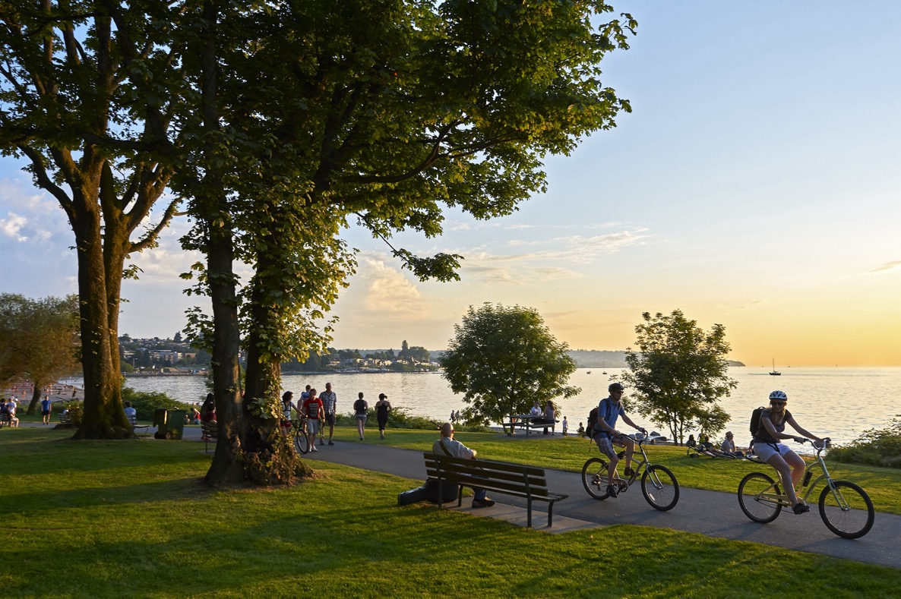
Taking a big picture perspective
Managing services AND assets
Notes:
Estimated time: 1 minute
Facilitation Tip: . This slide quickly provides a good perspective of asset management.
Customization Opportunity: Either select the “illustrative example” included in the Speaking Notes below or give your own example of how this might apply to a municipal asset in your community. Consider the lenses of climate, equity, and reconciliation.
Speaking Notes:
When managing assets, it’s essential to take a big picture perspective by focusing on services rather than individual assets, subtly considering the broader context of environmental, social, and cultural factors.
This approach allows us to prioritize investments based on overall community needs, ensuring that we provide equitable and accessible services for all, while acknowledging the importance of climate resilience and cultural heritage.
Engagement/Reflection Question:
How can we apply this big picture perspective to our municipality to better serve our community?
Illustrative Example:
Let's consider two parks in our community – one in a well-served area and another in an underserved area. Focusing on services rather than individual assets might lead us to invest more resources in improving the park in the underserved area, ensuring equitable access to green spaces for all residents. This approach would also involve assessing both parks’ resilience to climate change and considering the cultural significance of the locations to promote reconciliation.

Slide 6
Managing assets?
Managing assets | Asset management
How do we keep our existing assets running? | Do our assets meet our community's need?
How can we reduce capital costs? | What is the capital and operating cost?
Notes:
Estimated time: 3 minutes
Facilitation Tip: Engagement Slide. This slide provides council more tangible perspectives on how asset management thinking and our approach to “managing assets” are changing.
Speaking Notes:
We already manage assets, so how is asset management different?
Traditionally, managing assets focused on the operational aspects of maintaining, repairing, and replacing assets. Asset management is a strategic and systematic approach to optimize investment, minimize risks, and deliver the desired service levels. Asset management involves integrating financial, environmental, social, and technical aspects to make informed decisions that maximize asset value.
Engagement/Reflection Questions:
How can we incorporate equity considerations into our asset management strategies to benefit all community members?
Can you share examples of a time when adopting an asset management approach has led to improved service delivery and resource allocation?

Slide 7
Avoiding surprises
According to the 2019 Canadian Infrastructure Report Card, most municipal infrastructure is over 20 years old!
Notes:
Estimated time: 2 minutes
Facilitation Tip: Inform Slide.
Speaking Notes:
An unexpected event, such as a sinkhole or infrastructure failure, can have a significant impact on communities. By incorporating proactive asset management strategies, we can mitigate risks and minimize service disruptions. This involves regular inspections, data-driven decision making, and effective resource allocation to address potential issues before they escalate.
Engagement/Reflection Questions:
How can we ensure that our asset management practices prioritize the needs of vulnerable populations who may be disproportionately affected by service disruptions?
Can you provide examples of municipalities that have successfully avoided surprises through robust asset management practices?
Most municipal infrastructure in Canada is over 20 years old, which means that many assets may be nearing the end of their useful lives. Even assets with much longer service lives, such as water and sewer systems, may start to require more frequent inspection and renewal.
Ultimately, it’s important to be proactive to avoid surprises when it comes to asset management. This means taking a comprehensive and strategic approach that considers the unique characteristics and needs of each asset, as well as the potential risks and opportunities posed by aging infrastructure.
By taking a proactive approach, and by leveraging the latest technology and asset management strategies, we can help ensure that our municipality’s infrastructure remains safe, reliable, and sustainable for years to come.

Slide 8
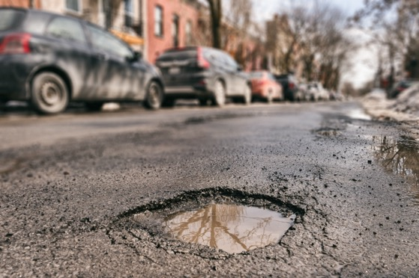
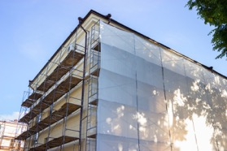
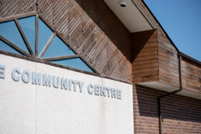
Why assets fail
Deterioration
Evolving community needs
Advancing capabilities and technology
Notes:
Estimated time: 3 minutes
Facilitation Tip: Inform Slide. This slide provides a high-level overview of the reasons assets fail and/or need to be replaced.
Speaking Notes:
Assets may fail due to deterioration, evolving community needs, or advancing capabilities and technology. Deterioration is a natural process resulting from aging, wear, and environmental factors. As communities grow and change, their needs and expectations shift, potentially rendering existing assets obsolete. Technological advancements can also make assets outdated, less efficient, or incompatible with modern systems.
Engagement/Reflection Question:
Can you share examples of assets that have failed due to these factors and how municipalities addressed them?
Physical deterioration is often the most visible sign of asset failure, but it is not the sole contributor. In fact, there are quite a few triggers.
As we know, wear and tear directly leads to physical deterioration that will eventually result in failure.
Secondly, and most critically, changes in climate and community needs may render certain assets insufficient, less relevant, or unnecessary, leading to their removal or redesign.
Finally, advancing technology can make existing assets obsolete and, in some cases, impossible to service or maintain. This is quite common, for example, with IT equipment.
Capturing the importance of services that are reliable, accessible and affordable for all the community segments that rely on them in clear level of service statements is a challenging and critical asset management step.

Slide 9
A continuous rebalance of priorities
Performance
Risk
Cost
Notes:
Estimated time: 3 minutes
Facilitation Tip: Key Message Slide. This slide provides a key message about the three competing priorities that must balance on an ongoing basis.
Speaking Notes:
There are three priorities that drive asset management decisions – the quality of the services delivered, the cost to deliver them and the potential risk.
This seems simple, but as assets age, we have to keep checking and making changes to ensure everything is working at its best.
Asset management involves a continuous rebalancing of priorities, balancing performance, risk, and cost. It requires careful navigation and decision making to achieve optimal outcomes.
Engage/Reflect Question:
What strategies can help our municipality navigate this complex balancing act?

Slide 10
Simple ≠ Easy
Complex
Must anticipate the future
Support living communities
Notes:
Estimated time: 1 minute
Facilitation Tip: Inform Slide. This slide provides context on the challenges of asset management.
Speaking Notes:
Asset management is complex:
We need to anticipate the future, while ensuring service continuity during renewal.
We need to engage multiple stakeholders and balance the competing priorities of performance, risk and cost.
Additionally, our assumptions are constantly changing due to factors such as technology, environmental conditions and community needs.
It requires collaboration, creativity, and resilience to navigate these challenges and make informed decisions that benefit the community.
As a result, asset management requires continued Council communication and a structured, iterative approach that maintains a high level of adaptation readiness.
Engage/Reflect Question:
Can you provide examples of municipalities that have successfully tackled the complexities of asset management to improve community outcomes?

Slide 11
Role of Council
Council sets strategic direction
Levels of service
Resource allocation
Notes:
Estimated time: 1 minute
Facilitation Tip: Inform slide.
Speaking Notes:
Council plays a crucial role in asset management by setting the strategic direction, defining Level of Service targets, and committing resources. Council’s leadership ensures alignment between community goals and asset management strategies.
Engagement/Reflection Question:
How can council members effectively engage with and support asset management initiatives?
Are there examples where our Council has historically made commitments to level of service or resource allocation/program support?

Slide 12
Sustainable services for the future
Notes:
Estimated time: 1 minute
Facilitation Tip: Key Message Slide.
Speaking Notes:
Successful asset management helps deliver sustainable services to current and future generations by optimizing resource use, minimizing risks, and addressing changing community needs. This long-term perspective aims to provide for the well-being and prosperity of the community for future generations.
Engagement/Reflection Questions:
How can municipalities (our municipality) balance short-term priorities with long-term sustainability goals in their (our) asset management practices?
What is our municipality’s vision for the future? What do we want our community to look like and be composed of?
How will those services be different from those we have today?
Is there an opportune time to pivot? (e.g., when assets require replacement)

Slide 13
Successful asset management is …
Doing the right thing
To the right asset
At the right time
Notes:
Estimated time: 1 minute
Facilitation Tip: Key Message Slide. This slide can provide a simple introductory conclusion to the presentation with a basic ‘takeaway’ about Asset Management that can be readily reiterated.
Speaking Notes:
Successful asset management involves doing the right thing to the right asset at the right time. This approach maximizes asset value, ensures service continuity, and optimizes resource allocation for the benefit of the community.
Additional Notes:
To consider: Can you provide examples of where you have achieved success by adopting parts of this asset management approach?
Are there recent examples in your municipality where this was not the case that might present an improvement opportunity?

Slide 14
Actions we can take today
Policy
Establish guidelines for effective and efficient decision-making
Resolution from Council
Equip staff with the resources to implement good asset management practices
Engagement
Dialogue with stakeholders to align asset management with community needs
Life-cycle costing
Look further into the future to anticipate future planning, construction, operations, maintenance, renewal and disposal costs
Notes:
Estimated time: 5 minutes
Facilitation Tip: Key Message Slide. This slide provides specific examples of how council can take action on asset management.
Speaking Notes:
There are several actions we can take to support and improve asset management.
First, developing or updating the asset management policy sets the tone for how assets are managed, and ensures that they align with broader municipal goals and objectives.
Second, passing a council resolution to support asset management will demonstrate the commitment of municipal leadership to asset management and can help secure the necessary resources and support to implement an effective asset management strategy.
Third, engaging with stakeholders, including community members and staff among others, will promote awareness of asset management benefits and can help build support for asset management.
Finally, adopting life-cycle costing as a key decision-making tool allows us to take into account the full cost of owning and operating an asset over its entire life cycle, rather than just the initial costs.
Remember, effective asset management is a continuous process that requires ongoing attention and investment. Adopting a comprehensive and strategic approach to asset management can ensure that our infrastructure remains safe, reliable, and sustainable for years to come.

Slide 15
Thank You!
This presentation was developed through the Municipal Asset Management Program, which is delivered by the Federation of Canadian Municipalities and funded by the Government of Canada.

Slide 16
Case study scenario: What was the lesson learned?
What happened?
How did you respond?
What opportunities are there to improve asset management planning?
Notes:
Estimated time: [include approx. duration to present your Case Study]
Facilitation Tip: Engagement and Example slide. Use this slide to create your own local case study scenario to incorporate into the presentation.
Customization Opportunity: Check-out Step 4 in the Facilitator’s Guide and Facilitator’s Worksheet for more, including ideas for what to include.
Speaking Notes: [add your speaking notes here]

