Slide 1
Asset management
Starting the conversation for sustainable service delivery
Notes:
Note to the Facilitator:
Welcome! This presentation template – Template 2 – is part of the “Starting the Conversation about Asset Management” toolkit.
Before starting to build your presentation, refer to the Facilitator’s Guide and Facilitator’s Worksheet that accompany this template.
How to use Template 2:
See Step 4 in the Guide and Worksheet for guidance and tips on choosing a template and selecting slides.
How to use these slides:
Select the slides that best suit your presentation goals and key messages.
Aside from the ‘title’ and ‘agenda,’ the background colour of the slide indicates the level of detail that it communicates:
dark green background (overall/general topic, introductory, less time required)
white background (more in-depth information on a topic, opportunity for enhanced audience engagement, more time required)
Look for these icons that indicate the type of slide:
Key Message [icon of a key]
Inform [icon of a megaphone]
Engagement [icon of two people talking]
Example [icon of a piece of paper and a magnifying glass]
Customize your slides and notes by adding or removing content and including local context and visual aids.
“Case Study” slides are located at the end of the template (slides 41–46)
How to use these notes:
Each slide contains the following information (where applicable):
Estimated time – indicates approximate time required to present slide content.
Facilitation Tip(s) – describes the slide and offers ideas on how to engage the audience.
Customization Opportunity – offers additional suggestions on content to add or other changes to make.
Speaking Notes – outline verbal points to be delivered to the audience. These notes can be added or adapted for customized slide content.
Engagement/Reflection Question(s): questions or prompts to engage your audience (either for individual reflection or large/small group discussion)
Illustrative examples: possible responses to help “unpack” the topics raised by the slide and answer audience questions.
Additional Notes – provide insights to consider, background information and/or resources where you can learn more to prepare for your presentation
-------------------------------------------------------------------------------------------------------------------------------------------------------------------
-------------------------------------------------------------------------------------------------------------------------------------------------------------------
Estimated Time: 30 seconds
Facilitation Tip: This title slide covers the overall goal and topics included in this presentation on asset management.
Customization Opportunity: Use or modify this title slide – or craft your own to capture your audience’s attention! It should convey your presentation goals and speak to your community’s asset management needs. (See Step 3 in the Guide and Worksheet for more on this.)
Speaking Notes:
Welcome, I am [your name & title]. Today I will be introducing you to asset management and how it makes our municipality more sustainable.
We will discuss strategies and tools that will ensure sustainable growth, inclusivity, and adaptability for our community's changing needs.

Slide 2
Land acknowledgement
We [I] would like to begin by acknowledging that the land on which we gather is the traditional [unceded territory of the Algonquin Anishnaabeg Nation.]
Notes:
Estimated time: This will depend on the land acknowledgement that you decide is appropriate for your presentation.*
Facilitation Tip: Many council sessions open with a land acknowledgement; however, if you are presenting at a session that did not, you should make your own acknowledgement.
A land acknowledgement is a customary protocol where you acknowledge the territory on which you stand and the people who own it. It’s a sign of respect and of recognition of the ties between the land and Indigenous peoples.
Customization Opportunity: Modify the slide to acknowledge the land where you are located. For more information, refer to the links below.
Speaking Notes:
We [I] would like to begin by acknowledging that the land on which we gather is the traditional unceded territory of the Algonquin Anishnaabeg Nation.
Additional Notes:
* “An informed acknowledgement is authentic, accurate, respectful, and spoken with heartfelt sincerity. It is not a platitude. The exercise of doing the research to find out on whose land a meeting or event is taking place is an opportunity to open hearts and minds to the past and make a commitment to contributing to a better future, which is the essence of reconciliation. There are multiple examples of land acknowledgement. Some are short and simple, while others will be more expansive. It’s up to you which words to choose and how deep you want to go,” (Indigenous Relations – Insights, Tips and Suggestions to make reconciliation a reality, 2019, Bob and Cynthia Joseph).
The sample text in the slide is an example for Ottawa and Gatineau:
For more information, follow this link: https://native-land.ca/maps-old/territories/algonquin/
For FCM’s land acknowledgement, follow this link: https://fcm.ca/en/about-fcm/corporate-resources/land-acknowledgement

Slide 3
Agenda
What is asset management?
Managing services and assets
Why assets fail
Asset management challenges
Council’s role
Notes:
Estimated time: 30 seconds
Facilitation Tip: This agenda slide provides a high-level snapshot of the presentation topics. In addition to presenting an overview of what you will cover in the presentation, you may also want to communicate any relevant procedural notes (i.e., time for questions, opportunities for large or small group discussions, etc.).
Customization Opportunity: Update the Agenda with your final presentation content.

Slide 4
Why invest in asset management? (4 mins)
Notes:
Estimated time: 4 minutes
Facilitation Tip: Consider whether this video is appropriate based on your council’s current knowledge of asset management. This is an effective engagement video if some members of Council are new to asset management.
Speaking Notes:
Let's start with a video that highlights the importance of investing in asset management to ensure we effectively maintain our assets and optimize resources to meet the needs of our growing community.

Slide 5
Icebreaker
Think about the most important asset in our community...
This could be anything from a local park to a community center, to a major roadway.
Notes:
Estimated time: 5 minutes
Facilitation Tip: Engagement Slide. Select either Slide 5 or Slide 6.
“Icebreaker” slides provide an opportunity for the audience to engage with the content of your presentation in more depth by connecting what they are learning with how it applies to their community and role in asset management.
Choose this “icebreaker” if you have new councillors or an audience that may be new to asset management.
Speaking Notes:
Let’s take a moment to think about the most important asset in our community. This could be anything from a local park to a community centre to a major roadway.
Once you have it in mind, turn to the person next to you, introduce yourself and share your choice and why.

Slide 6
Icebreaker
Think about the most important service in our community...
Write down the critical infrastructure required to support this service.
Notes:
Estimated time: 5 - 10 minutes
Facilitation Tip: Engagement Slide. Select either Slide 5 or Slide 6.
This “icebreaker” will require Council to have a basic understanding of asset management and their municipality's services.
Choose this “icebreaker” if you have councillors that are deeply engaged in asset management.
Invite audience members to reflect on what they consider to be the most important service in their community and what critical infrastructure enables this service. (2 min)
Ask audience members to share their choice with the person next to them (2 min)
Invite audience members to share their examples with the larger group.
As optional follow-up questions, you may ask audience members to consider the various tasks and/or aspects involved in delivering the service and who is involved.
Speaking Notes:
Let’s each take a moment to consider the most critical or important service in our community. What critical infrastructure supports its delivery?
Once you have it in mind, turn to the person next to you - share your choice and why.
Would anyone like to share their example?

Slide 7
What is asset management?
Notes:
Estimated time: 1 minute
Facilitation Tip: Inform Slide.
Speaking Notes:
In simple terms, asset management is the practice of managing a municipality's physical assets, such as buildings, infrastructure, parks, and community centres, in a strategic and effective manner, with an underlying awareness of various factors that impact communities.
Asset management involves a range of activities, including regular inspections of the assets to assess their condition, estimating the cost of maintenance and replacement over their lifespan, and prioritizing the maintenance and repair of the assets. These activities should also consider the potential influence of changing environmental conditions and the resilience of assets in the face of such changes.
Ultimately, the goal of asset management is to ensure that the municipality's assets are well-maintained and operating efficiently, which helps reduce costs and extend the lifespan of assets. A holistic approach takes into account the diverse needs of the entire community, recognizing that assets should serve everyone equitably and contribute to a sense of belonging and unity.

Slide 8
Asset management is…
What do we own?
Where is it?
What does it do?
What is it worth?
What condition is it in?
What needs to be done?
When does it need to be done by?
Notes:
Estimated time: 2 minutes
Facilitation Tip: Give an example of how this might apply to a specific municipal asset in your community. Consider the various lenses of climate, equity, and reconciliation.
Speaking Notes:
When discussing asset management, we need to consider the following questions, with an awareness of environmental, social, and economic factors:
1. What do we own?
2. Where is it?
3. What does it do?
4. What is it worth?
5. What condition is it in?
6. What needs to be done?
7. When does it need to be done by?
By answering these key questions, we can make informed decisions to allocate resources and manage assets effectively, while taking into account the broader implications for the community and its diverse needs.
According to Building Sustainable and Resilient Communities with Asset Management, a Triple Bottom Line assessment “[integrates] socio-cultural, economic and environmental considerations when evaluating service delivery options. It recognizes that a holistic and balanced assessment is required to achieve the best long-term outcome.”
Addition Information:
“Building Sustainable and Resilient Communities with Asset Management: An Introduction for Municipal Leaders,” FCM:
https://fcm.ca/en/resources/mamp/guide-building-sustainable-communities-asset-management

Slide 9
Taking a big picture perspective
Managing services AND assets
Notes:
Estimated time: 1 minute
Facilitation Tip: Select either Slide 9 or Slide 10 based on the assessment of your council’s awareness that you completed in Step 2 of the Facilitator’s Guide. This slide quickly provides a good perspective of asset management.
Customization Opportunity: Either select the “illustrative example” included in the Speaking Notes below or give your own example of how this might apply to a municipal asset in your community. Consider the lenses of climate, equity, and reconciliation.
Speaking Notes:
When managing assets, it’s essential to take a big picture perspective by focusing on services rather than individual assets, subtly considering the broader context of environmental, social, and cultural factors.
This approach allows us to prioritize investments based on overall community needs, ensuring that we provide equitable and accessible services for all, while acknowledging the importance of climate resilience and cultural heritage.
Engagement/Reflection Question:
How can we apply this big picture perspective to our municipality to better serve our community?
Illustrative Example:
Let's consider two parks in our community – one in a well-served area and another in an underserved area. Focusing on services rather than individual assets might lead us to invest more resources in improving the park in the underserved area, ensuring equitable access to green spaces for all residents. This approach would also involve assessing both parks’ resilience to climate change and considering the cultural significance of the locations to promote reconciliation.

Slide 10
Complete thinking
Determining community needs
Adapting the Community
Plan
Building the Community Plan
Notes:
Estimated time: 1-3 minutes
Facilitation Tip: Inform and Engagement Slide. This slide provides better engagement but takes more time to present than Slide 9. Consider using the Slides 11, 12 and 13, if you are presenting virtually.
Speaking Notes:
Asset management enables sustainable communities and is embedded throughout our community planning, implementation, and adaptation processes, while considering environmental, social, and cultural factors.
By identifying essential services and engaging with diverse stakeholders, we create a more holistic vision for our community. As we launch programs and invest in assets, we must leverage partnerships and monitor progress so we efficiently allocate resources and execute projects. Sustainable planning requires adapting to changing community demographics and maintaining assets proactively, with an emphasis on addressing the needs of all community members.
This diagram illustrates a more holistic approach to sustainable service delivery:
Determining Community Needs -> Setting Service Levels, considering climate, equity, and reconciliation.
Assessing the Community Plan -> Assessing if we are achieving Service Levels, while accounting for diverse community perspectives.
Implementing the Community Plan -> Strategizing how to maintain Service Levels given anticipated changes, ensuring long-term resilience and inclusivity.
Engage/Reflect Questions:
How can we ensure that our community planning process is inclusive and addresses the needs of all community members, including those who may face barriers and/be disproportionately impacted by climate change?
What are some examples of successful community planning initiatives that have resulted in big changes in how services were delivered in our community? Did this result in more or less infrastructure, or perhaps more efficient use of existing assets?
Additional Notes:
For more information on incorporating sustainable practices in asset management planning:
“Building Sustainable and Resilient Communities with Asset Management: An Introduction for Municipal Leaders,” FCM
https://fcm.ca/en/resources/mamp/guide-building-sustainable-communities-asset-management

Slide 11
Complete thinking: Planning for thriving communities
Identify essential services
Assess the needs of the community to determine required services for a prosperous and sustainable future.
Engage stakeholders
Collaborate with all voices in the community to ensure complete representation of perspectives in the planning process.
Balance long-term and short-term goals
Integrate short-term initiatives with long-term strategies for sustainable growth and development.
Notes:
Estimated time: 2 minutes
Facilitation Tip: Engagement Slide. Consider whether this level of detail is suitable for your council at this time.
Speaking Notes:
Community planning is crucial to creating thriving communities.
Identifying essential services and engaging with diverse stakeholders ensures a more comprehensive understanding of community needs. Balancing long-term and short-term goals is key to achieving sustainable growth and development while addressing immediate concerns, as well as fostering inclusivity and resilience.
Engage/Reflect Question:
Can you share an example from our community where balanced long-term and short-term goals led to positive outcomes for various community members? Were there any environmental, social, and cultural considerations?

Slide 12
Complete thinking: Building the community vision
Prioritize projects
Evaluate and prioritize initiatives based on risk including community needs, available resources, and potential impact.
Leverage partnerships
Collaborate with public, private, and non-profit partners to maximize resources and expertise.
Monitor progress
Implement effective project management and tracking systems to ensure successful execution and accountability.
Notes:
Estimated time: 2 minutes
Facilitation Tip: Engagement Slide. Consider whether this level of detail is suitable for your council at this time.
Speaking Notes:
Community planning involves prioritizing projects, leveraging partnerships, and monitoring progress.
Evaluating and prioritizing initiatives based on community needs, resources, and potential impact ensures effective resource allocation.
Collaboration with various partners maximizes resources and expertise, while effective project management and tracking systems ensure successful execution and accountability.

Slide 13
Complete thinking: Sustaining communities
Adapt to change
Adjust service levels and repurpose assets to efficiently accommodate fluctuating community demographics and needs.
Manage and maintain assets
Implement proactive maintenance strategies to preserve and extend the life of community assets.
Engage the community consistently
Encourage active community participation in decision-making processes to ensure evolving needs are met and priorities remain aligned.
Notes:
Estimated time: 2 minutes
Facilitation Tip: Engagement Slide. Consider whether this level of detail is suitable for your council at this time.
Speaking Notes:
For us to sustain the plan, we’ll need to adapt to community growth or decline, proactively manage and maintain our assets, and consistently engage the community. Assessing and adjusting service levels to accommodate fluctuating community demographics ensures evolving needs are met. Implementing proactive maintenance strategies preserves and extends asset life, while encouraging active community participation in decision-making processes will ensure our efforts align with community priorities.
Optional Speaking notes for municipalities experiencing population decline:
Exploring innovative solutions, such as public-private partnerships, shared service agreements, or repurposing underutilized assets, can help maintain service levels while managing costs. Additionally, focusing on economic development initiatives to attract new businesses and residents can contribute to long-term sustainability.

Slide 14
Managing assets?
Managing assets | Asset management
How do we keep our existing assets running? | Do our assets meet our community's need?
How can we reduce capital costs? | What is the capital and operating cost?
Notes:
Estimated time: 3 minutes
Facilitation Tip: Engagement Slide. This slide provides council more tangible perspectives on how asset management thinking and our approach to “managing assets” are changing.
Speaking Notes:
We already manage assets, so how is asset management different?
Traditionally, managing assets focused on the operational aspects of maintaining, repairing, and replacing assets. Asset management is a strategic and systematic approach to optimize investment, minimize risks, and deliver the desired service levels. Asset management involves integrating financial, environmental, social, and technical aspects to make informed decisions that maximize asset value.
Engagement/Reflection Questions:
How can we incorporate equity considerations into our asset management strategies to benefit all community members?
Can you share examples of a time when adopting an asset management approach has led to improved service delivery and resource allocation?

Slide 15
Evolving infrastructure paradigms
Historical | Today’s reality
Purpose-built | Multi-use and flexible
Meet historical operating conditions | Prepared for tomorrow's operating environment
Notes:
Estimated time: 3 minutes
Facilitation Tip: Engagement Slide. This slide provides council with a forward-looking perspective to build support for asset management. Consider whether any of your thoughts from Step 1 of the Facilitator’s Workbook could inform this discussion.
Speaking Notes:
Historically, infrastructure design focused on purpose-built, single-use assets. Today's paradigm emphasizes multi-use, adaptive, and forward-looking infrastructure that can respond to changing community needs, environmental challenges, and technological advancements. This shift promotes flexibility, resilience, and efficient use of resources.
Engagement/Reflection Questions:
How can we design infrastructure that is adaptable and serves diverse population needs, now and in the future?
What are some innovative examples of multi-use or adaptive infrastructure projects that have successfully addressed diverse community needs?

Slide 16
Avoiding surprises
According to the 2019 Canadian Infrastructure Report Card, most municipal infrastructure is over 20 years old!
Notes:
Estimated time: 2 minutes
Facilitation Tip: Inform Slide.
Speaking Notes:
An unexpected event, such as a sinkhole or infrastructure failure, can have a significant impact on communities. By incorporating proactive asset management strategies, we can mitigate risks and minimize service disruptions. This involves regular inspections, data-driven decision making, and effective resource allocation to address potential issues before they escalate.
Engagement/Reflection Questions:
How can we ensure that our asset management practices prioritize the needs of vulnerable populations who may be disproportionately affected by service disruptions?
Can you provide examples of municipalities that have successfully avoided surprises through robust asset management practices?
Most municipal infrastructure in Canada is over 20 years old, which means that many assets may be nearing the end of their useful lives. Even assets with much longer service lives, such as water and sewer systems, may start to require more frequent inspection and renewal.
Ultimately, it’s important to be proactive to avoid surprises when it comes to asset management. This means taking a comprehensive and strategic approach that considers the unique characteristics and needs of each asset, as well as the potential risks and opportunities posed by aging infrastructure.
By taking a proactive approach, and by leveraging the latest technology and asset management strategies, we can help ensure that our municipality’s infrastructure remains safe, reliable, and sustainable for years to come.

Slide 17
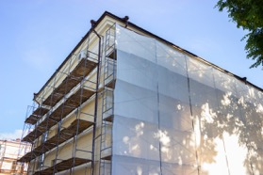
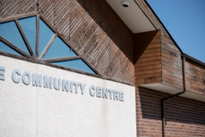
Why assets fail
Deterioration
Evolving community needs
Advancing capabilities and technology
Notes:
Estimated time: 3 minutes
Facilitation Tip: Inform Slide. This slide provides a high-level overview of the reasons assets fail and/or need to be replaced.
Speaking Notes:
Assets may fail due to deterioration, evolving community needs, or advancing capabilities and technology. Deterioration is a natural process resulting from aging, wear, and environmental factors. As communities grow and change, their needs and expectations shift, potentially rendering existing assets obsolete. Technological advancements can also make assets outdated, less efficient, or incompatible with modern systems.
Engagement/Reflection Question:
Can you share examples of assets that have failed due to these factors and how municipalities addressed them?
Physical deterioration is often the most visible sign of asset failure, but it is not the sole contributor. In fact, there are quite a few triggers.
As we know, wear and tear directly leads to physical deterioration that will eventually result in failure.
Secondly, and most critically, changes in climate and community needs may render certain assets insufficient, less relevant, or unnecessary, leading to their removal or redesign.
Finally, advancing technology can make existing assets obsolete and, in some cases, impossible to service or maintain. This is quite common, for example, with IT equipment.
Capturing the importance of services that are reliable, accessible and affordable for all the community segments that rely on them in clear level of service statements is a challenging and critical asset management step.

Slide 18
Why assets fail
Increasing financial burden
Preventive replacement can save costs as maintenance expenses escalate due to changes in consumables, labour, parts availability or regulation.
Physical deterioration
As assets are used, wear and tear, exposure to weather and third-party damage will eventually exceed safe operating condition.
Advancing technology
Infrastructure assets in good condition can become obsolete due to technology improvement and supply chain loss.
Evolving climate & community needs
Communities and climate change over time. Services must adapt to severe weather and meet the unique needs of different segments of the community.
Notes:
Estimated time: 3 minutes
Facilitation Tip: Engagement Slide. This slide provides more text than Slide 17 and may be more suitable for a virtual presentation where text is often more helpful.
Speaking Notes:
Physical deterioration is often the most visible sign of asset failure, but it is not the sole contributor. In fact, there are quite a few triggers.
As our economy changes, the cost of maintaining a particular asset can increase disproportionately if there are changes in regulations or consumable costs. For example, accounting for carbon emissions increases the calculated cost of fossil fuel–powered vehicles.
As we know, wear and tear directly leads to physical deterioration that will eventually result in failure.
Third, advancing technology can make existing assets obsolete and in some cases, make them impossible to service or maintain. This is quite common, for example, with IT equipment.
Finally, and most critically, changes in climate and community needs and priorities may render certain assets insufficient, less relevant, or unnecessary, leading to their removal or redesign.
Capturing the importance of services that are reliable, accessible and affordable to all the community segments that rely on them in clear level of service statements is a challenging and critical asset management step.

Slide 19
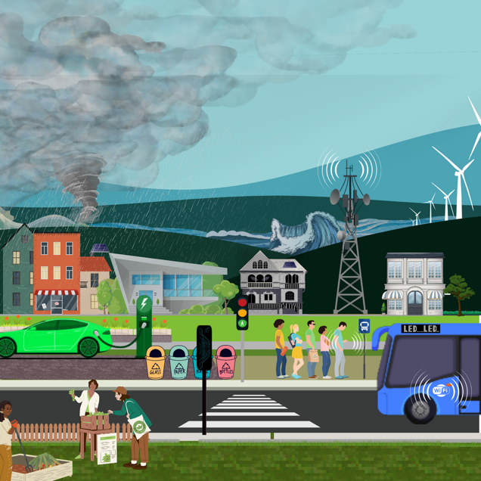
Preparing for the future
Change is expected!
Notes:
Estimated time: 1 minute
Facilitation Tip: Key Message Slide. This slide provides the key message that our communities and environment are changing and requires being proactive.
Speaking Notes:
Change is inevitable, and we must anticipate and adapt to these shifts. This requires a proactive approach to asset management, considering long-term trends, emerging technologies, and potential changes in community needs and expectations.
Engage/Reflect Question: How can we integrate future-oriented thinking into our asset management strategies?
Here are some examples of what has changed, shown here:
- Gas stations converted to EV chargers
- Improved Wireless telecommunications (and cell towers)
- Risk of storms (see tsunami in distance and windstorm)
- Recycling/waste sorting & diversion programs
- Cleaner energy sources and air quality
- More signalized intersections

Slide 20
A continuous rebalance of priorities
Performance
Risk
Cost
Notes:
Estimated time: 3 minutes
Facilitation Tip: Key Message Slide. This slide provides a key message about the three competing priorities that must balance on an ongoing basis.
Speaking Notes:
There are three priorities that drive asset management decisions – the quality of the services delivered, the cost to deliver them and the potential risk.
This seems simple, but as assets age, we have to keep checking and making changes to ensure everything is working at its best.
Asset management involves a continuous rebalancing of priorities, balancing performance, risk, and cost. It requires careful navigation and decision making to achieve optimal outcomes.
Engage/Reflect Question:
What strategies can help our municipality navigate this complex balancing act?

Slide 21
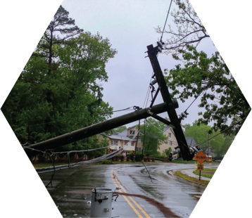
Balancing priorities
Performance
What service is required
Where it must be delivered
Risk
How might service be disrupted?
How likely are each of these events?
Cost
Asset costs are directly impacted by economic inflation
Many asset have existing backlogs
Notes:
Estimated time: 3 minutes
Facilitation Tip: Engagement Slide. This slide provides an opportunity to discuss Performance, Risk and Cost in more detail. It can be included if this is a topic your Council is interested in.
If one these areas is of particular interest, one of the following three slides (22, 23 or 24) can be used to keep the discussion specific.
Speaking Notes:
To balance priorities, we must consider performance, risk, and cost. Measuring performance involves understanding required services and where they must be delivered. Assessing risk helps identify potential service disruptions and their likelihood. Cost considerations include economic inflation and addressing existing backlogs.
Engagement/Reflection Question:
How can we ensure that we effectively balance these priorities in our asset management approach?

Slide 22
Balancing priorities: Performance
Measured through defined levels of service
Levels of service outline:
What service is required
Where it must be delivered
Notes:
Estimated time: 3 minutes
Facilitation Tip: Inform Slide.
Speaking Notes:
Performance is a crucial aspect of asset management, and it is measured through the Levels of Service (or LoS) provided to the community. LoS are the tangible outcomes delivered by assets, and they help define the quality, quantity, reliability, and responsiveness of services provided to the community.
When assessing performance, it’s essential to consider customer expectations, regulatory requirements, benchmarking, and monitoring:
Customer expectations: Understand the community’s expectations for the services provided by the assets. Regular consultation and feedback collection can help gauge customer satisfaction and identify areas for improvement.
Regulatory requirements: Ensure that the services provided by the assets meet applicable laws, regulations, and industry standards.
Benchmarking: Compares the performance of your assets and services with those of similar municipalities or industry standards. This can help identify areas for improvement and set performance targets.
Monitoring: Regularly monitor and evaluate the performance of assets and services against established targets and adjust asset management strategies accordingly.
Engage/Reflect Question:
How can we ensure that our performance measures and levels of service consider the needs and expectations of diverse community members?
Can you provide examples of municipalities that have successfully optimized asset performance to enhance service delivery?

Slide 23
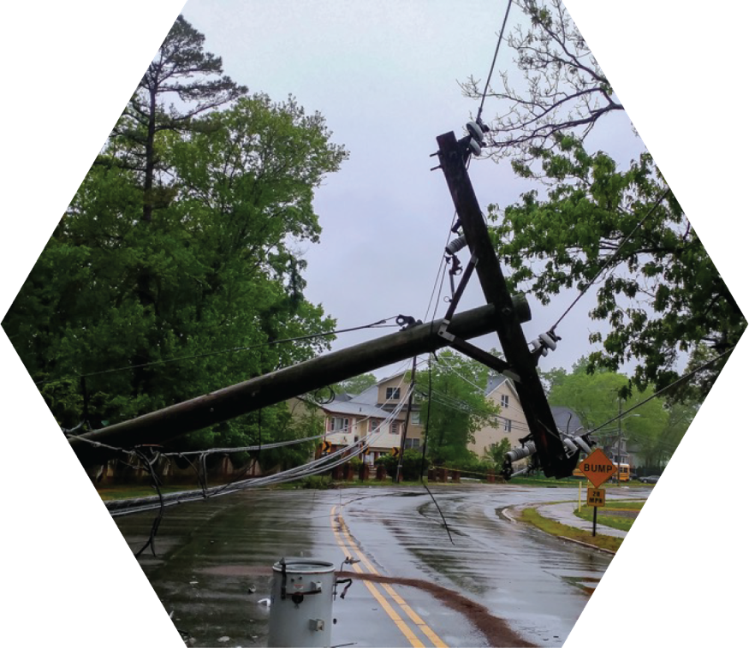
Balancing priorities: Risk
What may cause service to be disrupted?
How likely are each of these events?
Can the impact of the disruption be avoided or reduced?
Notes:
Estimated time: 3 minutes
Facilitation Tip: Inform Slide.
Speaking Notes:
Assessing risk is an integral component of asset management, as it helps identify and assess potential service disruptions and their likelihood. Understanding and managing risk enables municipalities to prioritize investments, allocate resources effectively, and ensure service continuity.
Key factors to consider when assessing risk include:
Probability of failure: Assess the likelihood of assets failing or underperforming, considering factors such as age, condition, and environmental impacts.
Consequence of failure: Evaluate the potential impacts of asset failure on service delivery, public safety, the environment, and the municipal budget.
Vulnerability: Identify assets that are more susceptible to failure due to factors such as location, materials, or design.
Mitigation strategies: Develop and implement strategies to reduce the risk of asset failure, such as maintenance, rehabilitation, or replacement.
Monitoring and updating: Regularly monitor and update risk assessments to reflect changes in asset conditions, community needs, and external factors.

Slide 24
Balancing priorities: Cost
Baseline asset costs are directly driven by economic inflation
Many assets have existing backlogs
Notes:
Estimated time: 3 minutes
Facilitation Tip: Inform Slide.
Speaking Notes:
Cost is a critical factor in asset management, as it influences resource allocation, investment decisions, and the overall financial sustainability of municipal services. Effective cost management helps optimize resource use and ensures the long-term viability of services. Good asset management results in cost-savings in the long-term, because reacting to disruptions is always more costly than planning for them proactively.
Key aspects to consider when evaluating costs include:
Lifecycle costs: Assess the total costs of owning, operating, maintaining, and disposing of assets over their entire lifecycle.
Economic inflation: Consider the impact of inflation on asset management costs and adjust budgetary projections accordingly.
Backlogs and deferred maintenance: Evaluate the financial implications of existing maintenance backlogs or deferred maintenance and prioritize investments to address these issues.
Cost optimization: Identify opportunities to minimize costs without compromising service levels, such as through asset sharing, innovative technologies, or process improvements.
Funding sources: Explore various funding sources to support asset management initiatives, including grants, partnerships, and alternative financing mechanisms.
Financial sustainability: Ensure that the financial management of assets aligns with long-term community goals and maintains the viability of services for future generations.
Engagement/Reflection Questions:
How can we ensure that our cost management practices consider the needs of diverse community members, including those with limited financial resources?
Can you provide examples where our municipality has successfully optimized costs to improve the financial sustainability of our asset management practices?

Slide 25
Simple ≠ Easy
Complex
Must anticipate the future
Support living communities
Notes:
Estimated time: 1 minute
Facilitation Tip: Inform Slide. This slide provides context on the challenges of asset management.
Speaking Notes:
Asset management is complex:
We need to anticipate the future, while ensuring service continuity during renewal.
We need to engage multiple stakeholders and balance the competing priorities of performance, risk and cost.
Additionally, our assumptions are constantly changing due to factors such as technology, environmental conditions and community needs.
It requires collaboration, creativity, and resilience to navigate these challenges and make informed decisions that benefit the community.
As a result, asset management requires continued Council communication and a structured, iterative approach that maintains a high level of adaptation readiness.
Engage/Reflect Question:
Can you provide examples of municipalities that have successfully tackled the complexities of asset management to improve community outcomes?

Slide 26
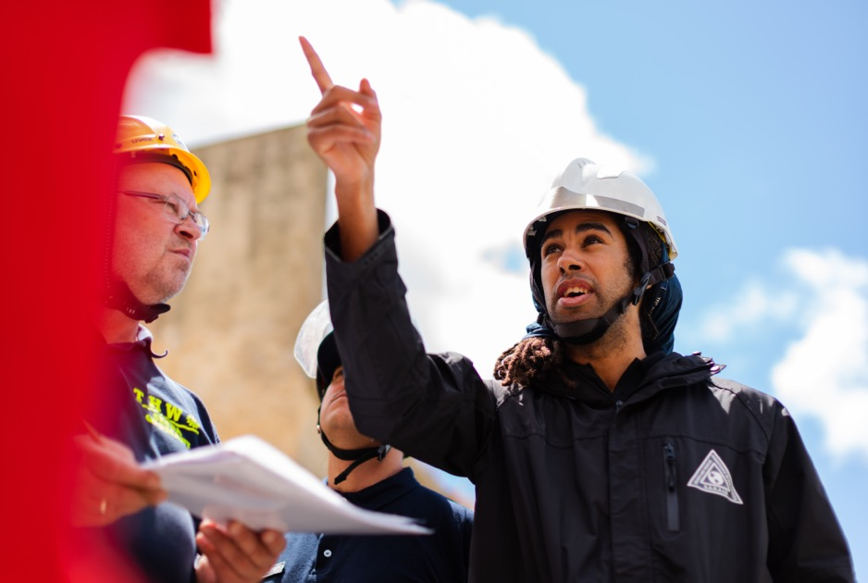
Ask questions like an asset manager…
Can we continue relying on current assets?
Will failure impact communities least able to accommodate it?
How can we best manage risk?
Notes:
Estimated time: 2 minutes
Facilitation Tip: Inform Slide. This slide provides context on the challenges of asset management.
Speaking Notes:
From an asset manager's perspective, critical questions include: Can we continue relying on existing assets? Will service disruption impact vulnerable communities? How can we as asset managers ensure that our decisions prioritize equity and inclusivity, considering the needs of vulnerable communities? How and where can we best manage risks? How many near misses today may become failure risks tomorrow?
Asset managers must consider these questions and adopt a comprehensive approach to asset management that addresses community needs, anticipates change, and minimizes risks.
Additional Notes:
To consider: What are the key skills and competencies required to be an effective asset manager in our municipality's environment?

Slide 27
Asset management is methodical
Assess
What is the current state of my assets and strategies?
Plan
What will we do to ensure assets deliver required services?
Implement
Execute planned activities and reassess.
Notes:
Estimated time: 2 minutes
Facilitation Tip: Inform Slide. This slide provides a high-level introduction to the general Asset Management approach and provides an opportunity to identify and discuss when Council can best provide input into the asset management process.
Speaking Notes:
Asset management follows a methodical process: assess the current state of assets, plan strategies and interventions, and implement those plans. This structured approach ensures the efficient use of resources and the delivery of desired service levels.
Engagement/Reflection Question:
How can our municipality maintain consistency in our asset management process while adapting to changing circumstances?

Slide 28
Inclusive AM thinking
Climate resiliency lens | Equity lens | Reconciliation lens
Do our design standards accommodate anticipated change? Do our assets enable proactive inspection and renewal without service impact? How often has service disruption almost occurred? | Is a single service level appropriate for the entire community? Does current consultation process reflect the community? Does my risk framework equitably recognize customers least able to mitigate service disruption? | Have Indigenous communities been engaged from the beginning? Do we acknowledge and respect Indigenous rights in our service areas? Are assets located in archaeologically significant areas?
Notes:
Estimated time: 5 minutes
Facilitation Tip: Inform and Engagement slide. Consider whether your council is prepared to discuss this level of detail. Slides 29, 30 and 31 provide more depth on each lens as well as additional information and sources.
Speaking Notes:
Inclusive asset management thinking incorporates Climate, Equity, and Reconciliation lenses.
This approach ensures that our decisions consider environmental impacts, advance equity, and respect the Indigenous right to self-determination.
Engagement/Reflection Question:
How can we effectively integrate these lenses into our asset management practices?
Additional Notes:
For more on the relationship between Climate Change, Equity, and Reconciliation, including definitions of key terms:
“Integrating Equity, Diversity and Inclusion into Municipal Climate Action,” PCP, FCM, ICELI: https://www.pcp-ppc.ca/resources/edi
“Climate Change Adaptation through an Equity Lens: How the City of Vancouver engaged vulnerable populations to understand their climate-related experiences and needs”, FCM: https://greenmunicipalfund.ca/case-studies/climate-change-adaptation-through-equity-lens

Slide 29
Inclusive AM thinking: Building resiliency to climate change
Anticipating change
Ensure design standards accommodate future climate scenarios, environmental and social shifts.
Proactive inspection and renewal
Design assets that facilitate regular maintenance without disrupting services.
Monitoring service disruption
Track near-miss incidents and addressing underlying vulnerabilities to improve overall resiliency.
Notes:
Estimated time: 3-5 minutes
Facilitation Tip: Inform and Engagement Slide. Consider whether this level of detail is suitable for your Council at this time.
Customization Opportunity: Consider adding examples of some or each of these from your municipality.
Speaking Notes:
As we navigate the challenges of climate change and shifting community needs, building resiliency into our asset management strategies is more important than ever. Anticipating change, proactively inspecting and renewing our assets, and monitoring service disruptions are critical to creating a more adaptable and resilient community.
We must ensure that our design standards accommodate future climate scenarios and adapt to environmental and social shifts. This proactive approach helps us create infrastructure that remains relevant and functional, addressing the diverse needs and vulnerabilities of community members as circumstances change.
A key aspect of resilient asset management is designing infrastructure that facilitates regular maintenance without disrupting services. By taking a proactive approach to inspection and renewal, we can minimize potential risks, extend asset lifespans, and ensure continued service delivery for all community members.
To enhance overall resiliency, it is crucial to track near-miss incidents and address underlying vulnerabilities. Identifying areas for improvement and taking corrective action can prevent future disruptions, ensuring a more resilient community that can better withstand the impacts of climate change and other challenges.
Additional Notes:
For more information on incorporating sustainable practices in asset management planning:
“Building Sustainable and Resilient Communities with Asset Management: An Introduction for Municipal Leaders,” FCM https://fcm.ca/en/resources/mamp/guide-building-sustainable-communities-asset-management
“Climate Change Adaptation through an Equity Lens: How the City of Vancouver engaged vulnerable populations to understand their climate-related experiences and needs”, FCM https://greenmunicipalfund.ca/case-studies/climate-change-adaptation-through-equity-lens

Slide 30
Inclusive AM thinking: Advancing equity and inclusivity
Tailored service levels
Assess whether a single service level is suitable for the entire community or if adjustment is needed to address unique needs.
Comprehensive community consultation
Engage diverse stakeholders and ensure all voices are heard and considered.
Equitable risk framework
Recognize and prioritize the needs of customers who are least able to mitigate service disruptions.
Notes:
Estimated time: 3-5 minutes
Facilitation Tip: Inform and Engagement Slide. Consider whether this level of detail is suitable for your council at this time.
Speaking Notes:
In our pursuit of effective asset management, we must prioritize equity and inclusivity, ensuring that our strategies and decisions are fair and considerate of all community members.
Tailoring service levels, engaging in comprehensive community consultations, and implementing an equitable risk framework enable us to promote a more inclusive and transparent approach to asset management.
Assessing whether a single service level is suitable for the entire community is crucial. In some cases, adjustments may be needed to address unique needs and circumstances, ensuring equitable access to essential services for everyone.
Engaging diverse stakeholders through comprehensive community consultations helps us capture a variety of perspectives and needs. By fostering open dialogue and ensuring all voices are heard and considered, we can develop more effective and inclusive asset management strategies.
Implementing an equitable risk framework involves recognizing and prioritizing the needs of the customers who are least able to mitigate service disruptions. This approach helps us focus resources on addressing critical vulnerabilities and protecting the most at-risk community members.
Additional Notes:
“Integrating equity, diversity and inclusion into municipal climate action”, Partners for Climate Protection https://www.pcp-ppc.ca/resources/edi
“How to embed equity and inclusivity in sustainable infrastructure”, C40 Cities Finance Facility https://c40cff.org/knowledge-library/how-to-embed-equity-and-inclusivity-in-sustainable-infrastructure
“Advancing Equity and Inclusion: A Guide for Municipalities”, City for All Women Initiative (CAWI) https://www.cawi-ivtf.org/publication/advancing-equity-and-inclusion/

Slide 31
Inclusive AM thinking: Committing to reconciliation
Respect for Indigenous rights
Recognize and respect Indigenous traditional rights within service areas and asset management decisions. Municipalities have a duty to consult!
Meaningful & ongoing engagement
Engage with Indigenous communities on whose lands AM is taking place from the beginning. Build relationships and ensure adequate time is factored into the process.
Archaeological significance
Identify and respect assets located in areas with historical or cultural importance.
“The United Nations Declaration on the Rights of Indigenous Peoples is the framework for reconciliation at all levels and across all sectors of society.”
– Truth and Reconciliation Commission of Canada, Ten Principles for Reconciliation, Principle 1
Notes:
Estimated time: 3-5 minutes
Facilitation Tip: Inform and Engagement Slide. Consider whether this level of detail is suitable for your council at this time.
Speaking Notes:
Committing to reconciliation in our decision-making processes is vital. Acknowledging and respecting Indigenous rights, meaningful and ongoing engagement with Indigenous peoples in decision-making processes, and respecting sites of archaeological significance are crucial to fostering stronger relationships with Indigenous communities and advancing a more equitable approach to asset management.
Recognizing and respecting Indigenous traditional rights within service areas and asset management decisions is a vital step towards reconciliation. Municipalities have a duty to consult, and by engaging meaningfully with Indigenous communities, we can ensure that their rights and perspectives are acknowledged and honoured in our decision-making processes.
Identifying and respecting assets located in areas with historical or cultural importance is essential. By recognizing the significance of these sites, we can better understand and appreciate the rich cultural heritage of the land and the peoples who have inhabited it for generations.
We must reflect on past asset designs and strive to minimize environmental impacts in current and future projects. This commitment to sustainability not only benefits the environment but also respects Indigenous values, knowledge and stewardship of the land.
Additional Notes:
For more information on Reconciliation and the 94 Calls to Action:
“ReconciliACTION Plans”, National Centre for Truth and Reconciliation https://nctr.ca/reconciliaction-plans/
To learn more about Indigenous rights:
“FAQ on the United Nations Declaration on the Rights of Indigenous Peoples”, National Centre for Truth and Reconciliation https://nctr.ca/undrip-faq/
“United Nations Declaration on the Rights of Indigenous Peoples”, United Nations https://social.desa.un.org/issues/indigenous-peoples/united-nations-declaration-on-the-rights-of-indigenous-peoples
“Why are Indigenous rights part of climate action? And other questions about UNDRIP,” Environmental Defence Guest Blog with Terri-Lynn Williams-Davidson, Nigel Grenier, and Elizabeth Bulbrook, White Raven Law https://environmentaldefence.ca/2019/11/18/indigenous-rights-part-climate-action-questions-undrip/
For more information on First Nation – Municipal partnerships:
“First Nation–Municipal Land Use Planning Tool,” CEDI, FCM, Cando https://fcm.ca/en/resources/cedi/first-nation-municipal-land-use-planning-tool
“Stronger Together: A Toolkit for First Nations-Municipal Community Economic Development Partnerships,” CEDI, FCM, Cando, https://fcm.ca/en/resources/cedi/stronger-together-toolkit

Slide 32
Our municipality runs on asset management:
Optimize existing processes
Improving how existing resources are used and managing existing risk
Manage user demand / usage behaviour
Reducing the need for more infrastructure
Replace or improve existing assets
Addressing aging and outdated assets or environmental change
Acquire new assets
Addressing growth, providing different service levels or improving system resiliency
Notes:
Estimated time: 3-5 minutes
Facilitation Tip: Inform and Engagement Slide.
Customization Opportunity: Consider whether the following is appropriate for your council*
Think of some examples of specific challenges that your municipality has faced and how they are being addressed, as a way to foster discussion.
Speaking Notes:
There is no single solution for all asset management challenges. Each municipality faces unique circumstances, and a tailored approach is necessary to address specific needs and priorities.
Engage/Reflect Question:
What are some creative approaches that municipalities have taken to address their unique asset management challenges?
There are four potential solutions for managing our assets: optimizing processes, managing demand, rehabilitating existing assets, and building new assets.
Each of these solutions has its own strengths and limitations and plays a role in a comprehensive asset management program. However, it’s important to note that there is no ‘magic wand’ that can solve all our asset management challenges.
Instead, a balanced and flexible approach is often required, one that takes into account the unique characteristics and needs of the community, as well as the specific challenges and opportunities posed by existing assets.
So, while it may be tempting to focus on one particular solution, such as building new assets, it’s important to remember that the most effective asset management strategies often involve a combination of approaches, tailored to the specific needs and challenges of our municipality.
It's important to keep this in mind to ensure asset management supports the long-term sustainability and prosperity of the community.

Slide 33
Role of Council
Council sets strategic direction
Levels of service
Resource allocation
Notes:
Estimated time: 1 minute
Facilitation Tip: Inform slide.
Speaking Notes:
Council plays a crucial role in asset management by setting the strategic direction, defining Level of Service targets, and committing resources. Council’s leadership ensures alignment between community goals and asset management strategies.
Engagement/Reflection Question:
How can council members effectively engage with and support asset management initiatives?
Are there examples where our Council has historically made commitments to level of service or resource allocation/program support?

Slide 34
Policy is a great place to start
Notes:
Estimated time: 1 minute
Facilitation Tip: Inform slide.
Speaking Notes:
Developing clear and comprehensive asset management policies provides a strong foundation for decision-making, resource allocation, and performance monitoring. Policies help ensure consistency and transparency in municipal asset management.
Engage/Reflect Questions:
What are some key components of our asset management policy?
Do we have supporting policies for areas such as data governance?

Slide 35
Sustainable services for the future
Notes:
Estimated time: 1 minute
Facilitation Tip: Key Message Slide.
Speaking Notes:
Successful asset management helps deliver sustainable services to current and future generations by optimizing resource use, minimizing risks, and addressing changing community needs. This long-term perspective aims to provide for the well-being and prosperity of the community for future generations.
Engagement/Reflection Questions:
How can municipalities (our municipality) balance short-term priorities with long-term sustainability goals in their (our) asset management practices?
What is our municipality’s vision for the future? What do we want our community to look like and be composed of?
How will those services be different from those we have today?
Is there an opportune time to pivot? (e.g., when assets require replacement)

Slide 36
Successful asset management is …
Doing the right thing
To the right asset
At the right time
Notes:
Estimated time: 1 minute
Facilitation Tip: Key Message Slide. This slide can provide a simple introductory conclusion to the presentation with a basic ‘takeaway’ about Asset Management that can be readily reiterated.
Speaking Notes:
Successful asset management involves doing the right thing to the right asset at the right time. This approach maximizes asset value, ensures service continuity, and optimizes resource allocation for the benefit of the community.
Additional Notes:
To consider: Can you provide examples of where you have achieved success by adopting parts of this asset management approach?
Are there recent examples in your municipality where this was not the case that might present an improvement opportunity?

Slide 37
Cooking up success =
Good data
+
Asset management planning
+
Resources
Notes:
Estimated time: 1 minute
Facilitation Tip: Key Message Slide. This slide can provide a simple conclusion to the presentation with a basic takeaway about Asset Management that can be readily reiterated.
Speaking Notes:
Cooking up success in asset management involves a combination of good data, asset management planning, and resource allocation. Reliable data informs decision making, while comprehensive planning and dedicated resources enable the implementation of effective asset management strategies.
Additional Notes:
To consider: Do you have all these components? What does your municipality need to build capacity and ensure access to quality data for informed asset management decision making?

Slide 38
Actions we can take today
Policy
Establish guidelines for effective and efficient decision-making
Resolution from Council
Equip staff with the resources to implement good asset management practices
Engagement
Dialogue with stakeholders to align asset management with community needs
Life-cycle costing
Look further into the future to anticipate future planning, construction, operations, maintenance, renewal and disposal costs
Notes:
Estimated time: 5 minutes
Facilitation Tip: Key Message Slide. This slide provides specific examples of how council can take action on asset management.
Speaking Notes:
There are several actions we can take to support and improve asset management.
First, developing or updating the asset management policy sets the tone for how assets are managed, and ensures that they align with broader municipal goals and objectives.
Second, passing a council resolution to support asset management will demonstrate the commitment of municipal leadership to asset management and can help secure the necessary resources and support to implement an effective asset management strategy.
Third, engaging with stakeholders, including community members and staff among others, will promote awareness of asset management benefits and can help build support for asset management.
Finally, adopting life-cycle costing as a key decision-making tool allows us to take into account the full cost of owning and operating an asset over its entire life cycle, rather than just the initial costs.
Remember, effective asset management is a continuous process that requires ongoing attention and investment. Adopting a comprehensive and strategic approach to asset management can ensure that our infrastructure remains safe, reliable, and sustainable for years to come.

Slide 39
Thank You!
This presentation was developed through the Municipal Asset Management Program, which is delivered by the Federation of Canadian Municipalities and funded by the Government of Canada.

Slide 40
Case studies
Notes:
*Note to the Facilitator: See Step 4 in the Facilitator's Guide and Facilitator's Worksheet for details and tips on selecting and customizing slides.
The following Case Study slides provide examples that help demonstrate some of the asset management concepts and considerations discussed in this presentation.
How to use the Case Studies (slides 41-46):
Customize these slides and notes by adding or removing content and including local context and visual aids (i.e., photos, graphs, charts)
Create your own Case Study Scenario using slide 47.
Can you think of a local example that illustrates asset management in action?
Move your ‘Case Study’ slide into the main presentation to illustrate and/or provide more context to ‘Information’ slides.

Slide 41
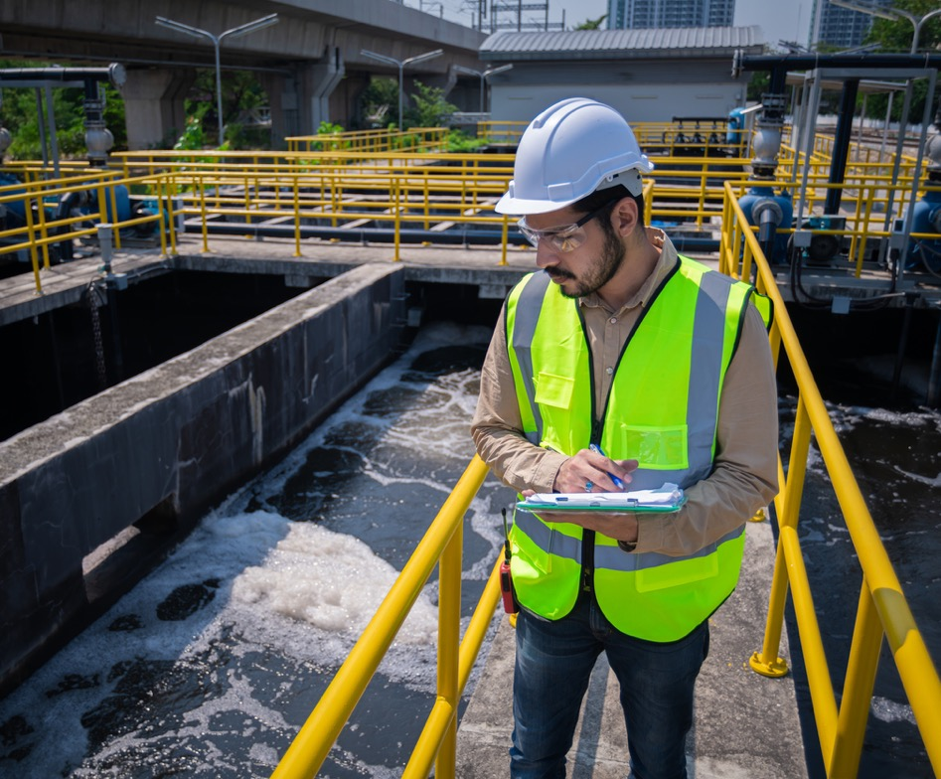
Case study scenario: Context-sensitive service levels
The water treatment facility must be temporarily shut down to replace the filtration system!
Not all users would be impacted equally.
Would critical users change if a road closure was required instead of a water shutdown?
Notes:
Estimated time: 2-3 minutes
Facilitation Tip: Example Slide. This slide is intended to highlight the need to assess risk and impact to the community equitably, and highlight how context must be assessed
Speaking Notes:
When service is disrupted, the location can significantly affect the impact to your community.
Here we see an illustration of a community –Would a watermain failure have a higher impact depending on where it failed? Vulnerable users like the hospital would probably need higher levels of service compared to city hall or the recreation centre, in this example.
This is a simple example of the need for context-sensitive service levels that can be applied to our municipality to identify vulnerable demographic areas.

Slide 42
Case study scenario: Interdependent municipal services
Continuous precipitation has caused flooding and the closure of some streets.
How would this indirectly impact...
Transit services?
Water services?
Notes:
Estimated time: 1-2 minutes
Facilitation Tip: Example Slide. This is a simple example of the need to consider risk across multiple services – a road closed to essential facilities or communities that highly depend on transit may warrant higher priority.
Speaking Notes:
When service is disrupted, it can impair other services our community depends on.
Here we see a flooded street.
Engagement/Reflection question:
Other than transportation, what other services might be impacted?
- Adjacent drainage areas?
- Transit services?
- Access to essentials such as fire or ambulance services? drinking water facilities?
- Sewer systems?
This is a simple example of the need to consider risk across multiple services – a road closed to essential facilities or communities that highly depend on transit may warrant higher priority.

Slide 43
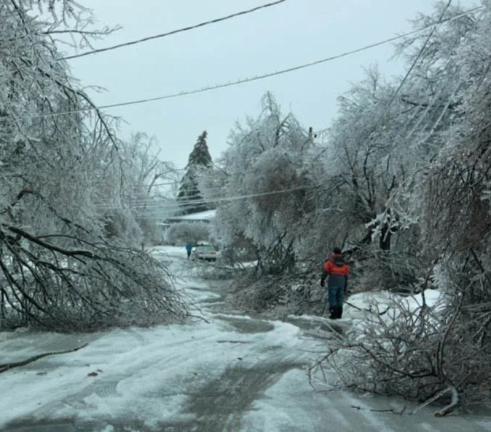
Case study scenario: Interdependent municipal services
Ice storms across Eastern Canada in 2013 resulted in severe power outages and road blockages.
How would the failure of power and roads impact...
Transit services?
Water services?
Notes:
Estimated time: 2-4 minutes
Facilitation Tip: Engagement and Example Slide. This slide highlights an ice storm, an increasingly frequent weather event, and provides a discussion point to highlight how resiliency in one area can provide improved resiliency for other services.
Speaking Notes:
When service is disrupted, it can impair other services our community depends on.
Here we see fallen trees from the ice storms in Eastern Canada in 2013. Other than power and telecommunication utilities, what other services might be impacted?
- Coordination of municipal services?
- Road blockages?
- Access to or shortages of operating consumables such as fuel and chemicals
This is a simple example of the need to consider emergency management or contingency plans and identifying critical facilities.
Engagement/Reflection Questions:
How can you use this information to improve asset management strategies?
How often do you replace assets like-for-like?
Are there better ways to deliver existing services?

Slide 44
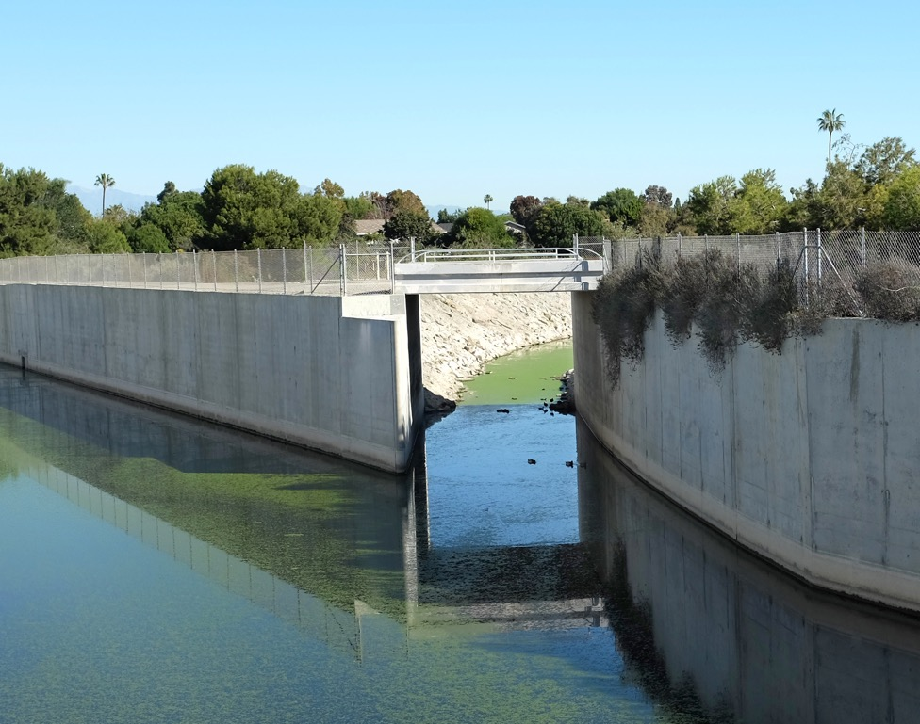
Case study scenario: Restoration opportunities
It was common to line creeks and streams with concrete when subdivisions were built in the 1950s.
How might this be designed today?
Could this be managed as a natural asset?
Notes:
Estimated time: 2-4 minutes
Facilitation Tip: Example Slide. This slide highlights a historical approach to storm-water management and presents an opportunity to improve through better insight today – specifically, through the use of a naturalized asset, which would provide better water retention, require less hard infrastructure and produce co-benefits for the community such as recreational opportunities.
Speaking Notes:
There are many cases where assets were designed with good ideas in mind, but better-informed options have been identified decades later.
Here we see a common approach to storm water management in the 1950s – creeks and streams were lined with concrete to increase storm drainage capacity as subdivisions with reduced permeability were built.
Why might we build something different today?
- Significant infrastructure (concrete) to monitor, rehabilitate and repair
- Doesn't integrate well into a community and could be a safety hazard
- Pre-existing habitat and environment were destroyed
Engagement/Reflection Questions:
Are there other examples where designs should be modernized?
How might a natural asset better meet the needs from an asset management perspective? Cost?
Additional Notes:
For more on how natural infrastructure assets can promote climate resiliency:
“Explainer: Natural Infrastructure Solutions for Climate Resilience,” International Institute for Sustainable Development, 2021. https://www.iisd.org/articles/explainer/natural-infrastructure-solutions-climate-resilience

Slide 45
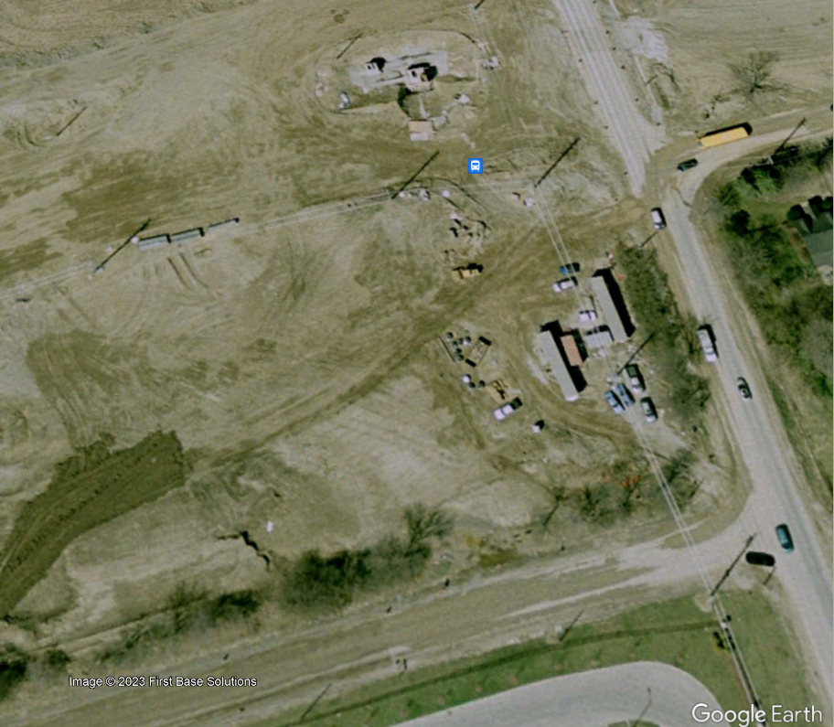
Case study scenario: Anticipating historical sites
In 2005, a Huron-Wendat ossuary was found when widening a road in York Region, Ontario.
First Nations were informed and the site was preserved.
How might the service impacts be mitigated?
Notes:
Estimated time: 2-4 minutes
Facilitation Tip: Example. This slide highlights the example of a discovery of burial grounds, and the respect and actions that must be incorporated into a project. From an asset management perspective, this also has the potential to disrupt services. York Region went on to create a map of sites with archaeological potential.
Speaking Notes:
Some infrastructure, like roads, requires improvements that disturb the surrounding environment, and can require additional land as it is expanded or updated.
In this case, a road realignment to improve traffic capacity in a rural area resulted in the discovery of a First Nations ossuary.
In addition to Municipalities’ duty to consult, this can result in delays and escalating costs for projects, with cascading impacts on other municipal services.
Engagement/Reflection Questions:
How might we gain a better understanding of where project risks might be?
Does our municipality have ESA maps, or maps identifying archaeologically significant areas?
Can these be considered when planning work?
Additional Notes:
For more information on land use planning laws and policies, include the duty to consult:
“First Nation–Municipal Land Use Planning Tool,” CEDI, FCM, Cando https://fcm.ca/en/resources/cedi/first-nation-municipal-land-use-planning-tool

Slide 46
Case study scenario: What was the lesson learned?
What happened?
How did you respond?
What opportunities are there to improve asset management planning?
Notes:
Estimated time: [include approx. duration to present your Case Study]
Facilitation Tip: Engagement and Example slide. Use this slide to create your own local case study scenario to incorporate into the presentation.
Customization Opportunity: Check-out Step 4 in the Facilitator’s Guide and Facilitator’s Worksheet for more, including ideas for what to include.
Speaking Notes: [add your speaking notes here]

