Slide 1
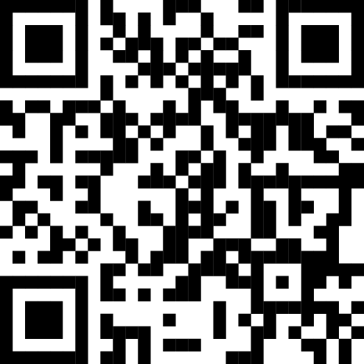
FCM March 2025 Board of Directors Meeting
Report to Council
Scan the QR code to access FCM’s advocacy microsite for the federal election.
FCM Board of Directors
March 2025

Slide 2


Context
Board meeting held in person March 17 – 20. Committee meetings held virtually two weeks prior.
U.S. trade war and federal election forming important background context, with numerous FCM delegations to US held recently.
Dorval, QC as the host municipality, who supplied study tours to the St Laurent Composting Centre and Montréal-Trudeau International Airport.

Slide 3
Advocacy Discussion – National Prosperity Partnership
At this board meeting, FCM facilitated discussion on our strategy for the 2025 federal election.
Throughout this federal election campaign, FCM is advocating a shift towards a prosperity agenda and a new National Prosperity Partnership.
Through FCM, municipalities are credible national partners, and would focus on facilitating dialogue and collaboration with other orders of government to deliver a more resilient and competitive national economy.
This is about aligning our orders of government for long-term efficiency in a challenging new economic reality. Adopting a modernized approach to municipal needs means local economies will have the long-term support they need, Canada’s economic future will be reinforced, and we can deliver the on the issues that matter to Canadians.

Slide 4
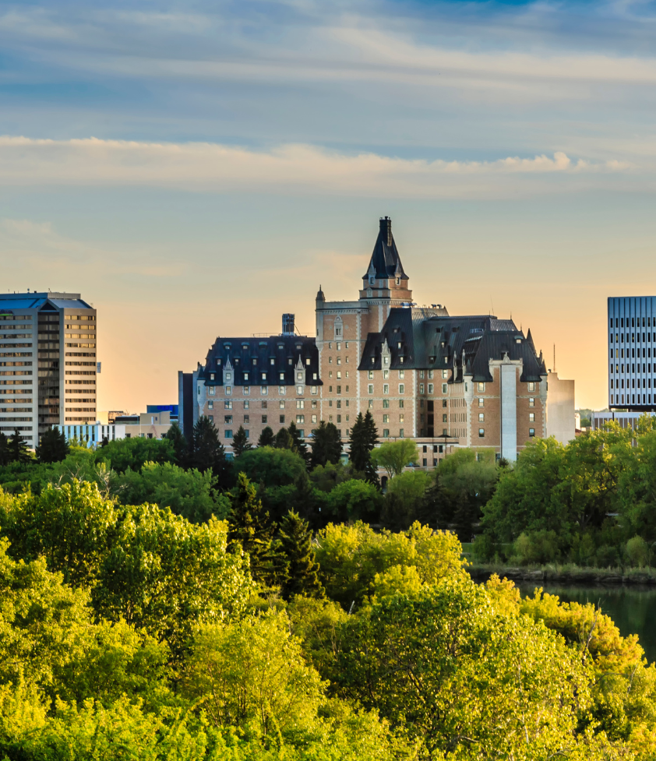
Key Issues for Federal Election 2025
A National Prosperity Partnership is needed to move Canada forward by ensuring all orders of government work together. This will ensure better progress on the key issues:
Supporting local economic growth and resilience so communities can attract businesses and ensure good jobs for Canadians.
Investing in infrastructure renewal to drive productivity and competitiveness.
Achieving housing affordability so Canadians (especially younger generations) can look to their future with confidence.
Ending homelessness with solutions that work at the local level.
Keeping communities safe and supporting vital emergency services.
Reducing economic disruption by investing in climate-resilient infrastructure.
Supporting thriving rural, northern and remote communities.

Slide 5
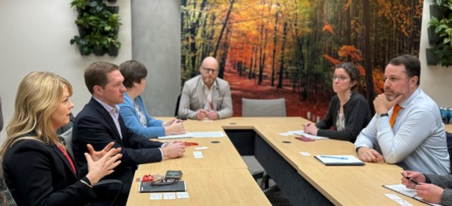
Advocacy Updates
Advocacy and delegations related to Canada / U.S. relations
Strategy: Leverage relationships with US mayors and associations Emphasize the negative economic impact that President Trump’s trade policies will have on U.S. communities, key messages tailored to each US region, asking US municipal leaders to speak with their federal officials to halt the tariffs.​
5 Different delegations now dispatched: ○ With Council of the Federation – Washington DC - Feb 10-12 ○ U.S. Conference of Mayors – Phoenix AZ - Feb 20-22 ○ National Association of Counties – Washington DC - March 1-4 ○ National League of Cities (NLC) – Washington DC - March 8-10 ○ Trilateral Summit (U.S. / Canada / Mexico) of U.S. Conference of Mayors – Washington DC - March 27-28 (post board)

Slide 6
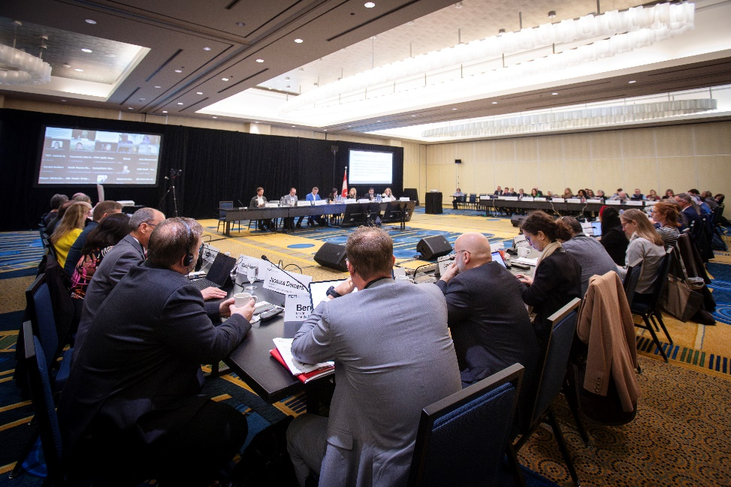
Board Meeting – Decisions Taken
Endorsing UNDRIP That FCM endorse and put in place actionable steps to embed its principles into FCM’s Reconciliation Strategy.
Strategic Plan That the Strategic Plan “Stronger together: Local strength, national prosperity” be approved.
FCM Budget 2025-2026

Slide 7
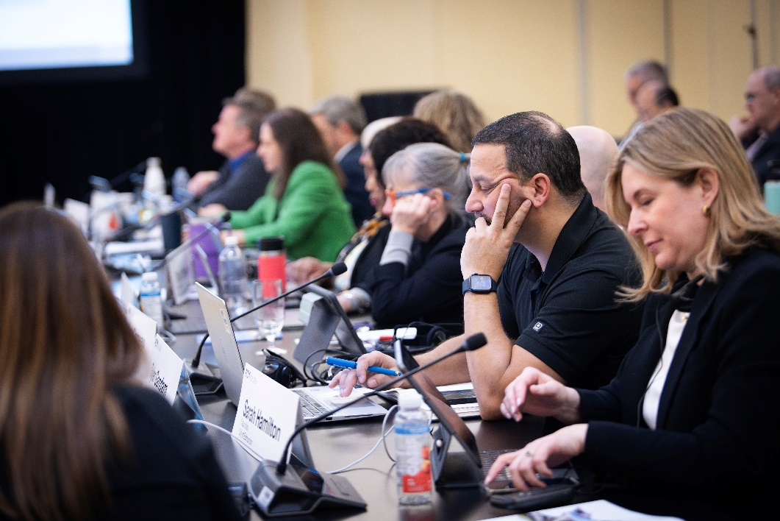
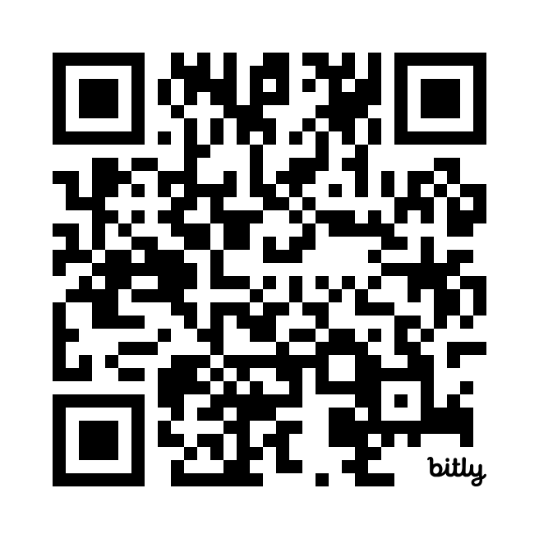
Board Meeting – Resolutions Adopted (1 of 2)
Supporting Canadians through a Stronger Canada Disability Benefit
Immigration Levels Plan
Food Insecurity – Groceries and Essentials Benefit
Cellular Coverage
Review all resolutions in our database:
https://fcm.ca/en/about-fcm/corporate-resources/fcm-resolutions

Slide 8
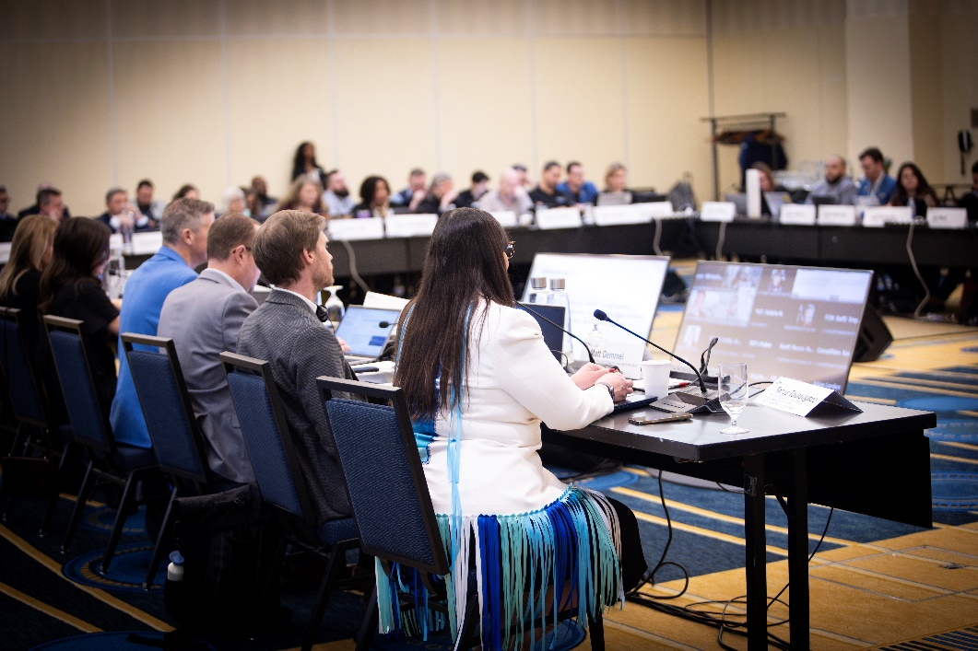
Board Meeting – Resolutions Adopted (2 of 2)
Healthcare Access
Standardized Wake Surfing Regulation
Online Sale and Importation of Fireworks
Enhancing Accessibility Under the Federal Plastic Straw Ban
Seeking Federal Support for a Federal Flushability Standard
Review all resolutions in our database:
https://fcm.ca/en/about-fcm/corporate-resources/fcm-resolutions

Slide 9

Next FCM Board Meeting + Annual Conference
Board of Directors’ virtual meeting: May 26
Annual Conference and AGM with board elections: May 29 to June 1, Rogers Centre, Ottawa, ON.

Slide 10

Stronger Together – Your Federal Election Hub
Visit strongertogether.fcm.ca for federal election tools , key messages, a draft letter and other resources.

